Slide 2
Industrial Wireless Networks
Services and Innovation for Industry 4.0 (SII40)
Xenofon (Fontas) Fafoutis Associate Professor xefa@dtu.dk
www.compute.dtu.dk/~xefa
20/7/2024
This lecture is licensed under CC BY 4.0

Slide 3
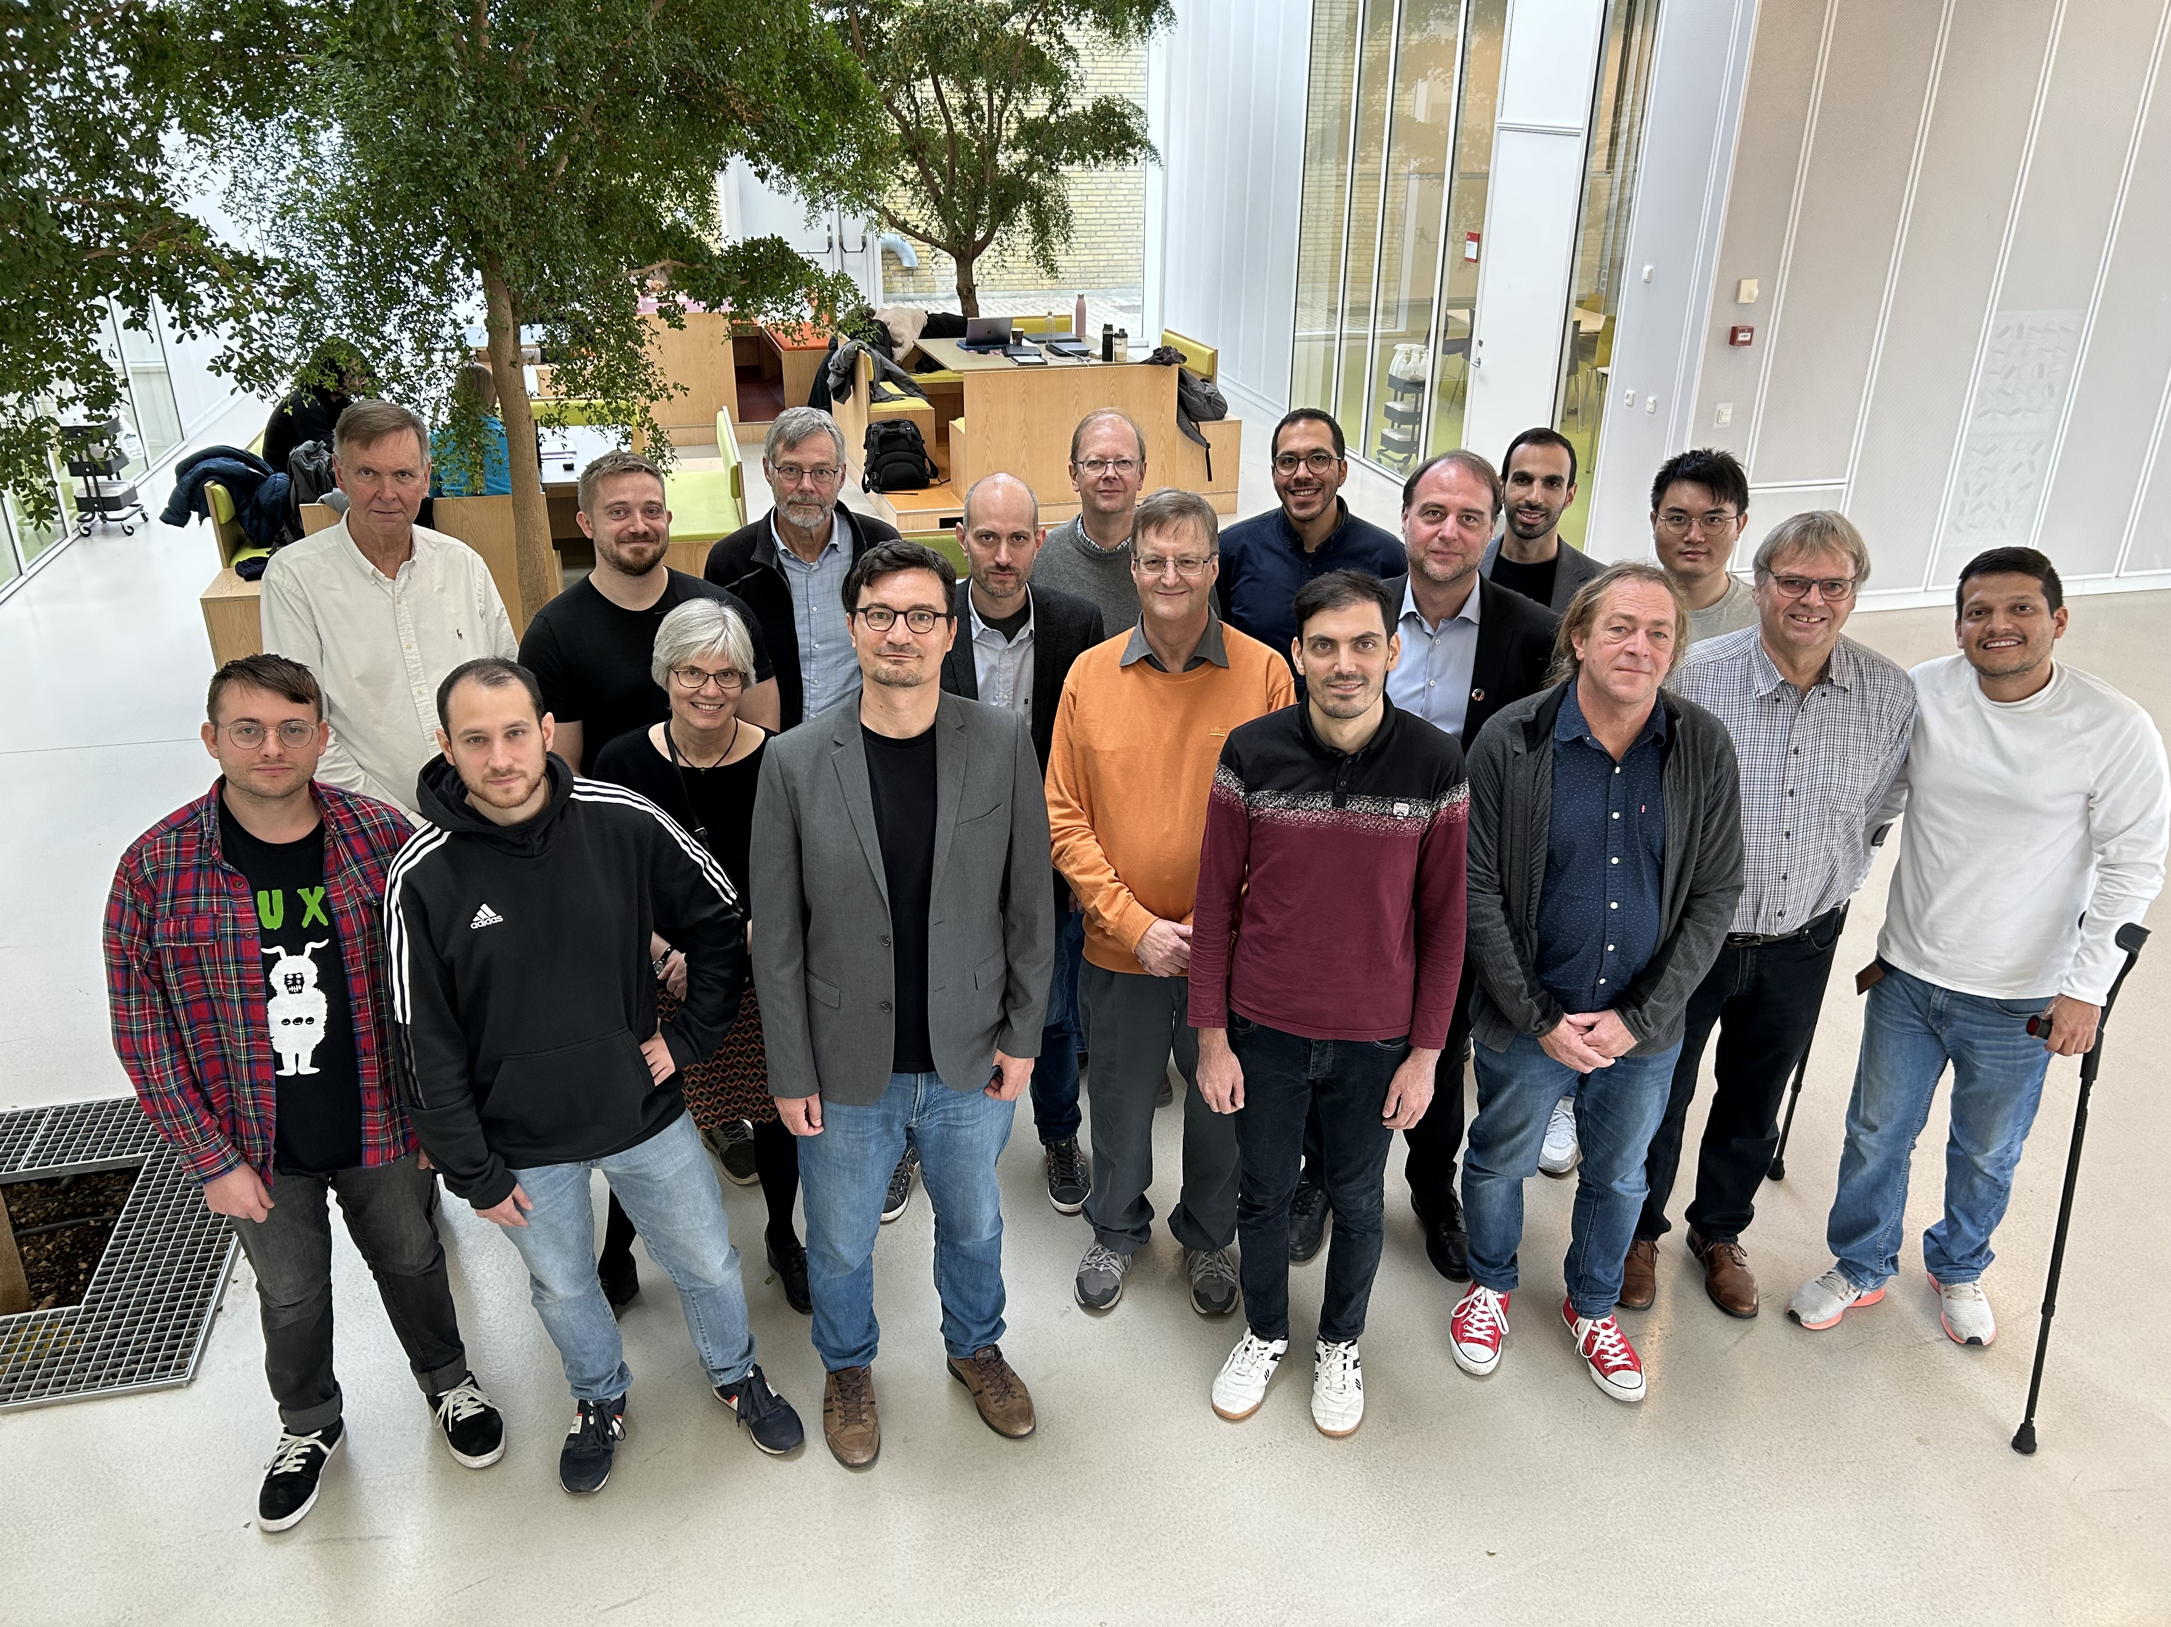
whoami
Associate Professor at DTU Compute
Section for Embedded Systems Engineering
https://www.compute.dtu.dk/sections/ese
Visiting Professor at UNIPR
Research Interests
Wireless Embedded Systems
Industrial Wireless Networks
Embedded AI
(Industrial) Internet of Things
More info: http://xefa.eu
Embedded Systems Engineering section October 2023

Slide 4
Lecture Outline
Introduction to Industrial Wireless Networks
Introduction to IEEE 802.15.4 TSCH
Time Synchronisation: Communication based on a randezvous
TSCH Mechanics: Time Slotting and Channel Hopping
TSCH Mechanics: Scheduling
TSCH Mechanics: Joining a TSCH Network

Slide 5
Requirements of (Industrial) Networked Embedded Systems
Scalability
Supported number of embedded systems
Throughput
Bytes received per second
Reliability (Packet Delivery Ratio, PDR)
Number of packets received over packets sent
Latency/Delay
Time interval from the time a packet is sent to the time packet received
Jitter
Variability of latency/delay
Time-sensitivity or determinism
Predictable/bounded latency and jitter
Energy Efficiency and Consumption
All above need energy

Slide 6
Requirements of (Industrial) Networked Embedded Systems
Scalability
Supported number of embedded systems
Throughput
Bytes received per second
Reliability (Packet Delivery Ratio, PDR)
Number of packets received over packets sent
Latency/Delay
Time interval from the time a packet is sent to the time packet received
Jitter
Variability of latency/delay
Time-sensitivity or determinism
Predictable/bounded latency and jitter
Energy Efficiency and Consumption
All above need energy
Trade-offs: There is no solution that optimises all; we need figure out what we can afford to sacrifice

Slide 7
Industrial Embedded Networks
Industrial Networks carry vital and often safety critical data
Tend to prioritise reliability and determinism over throughput and energy efficiency
Best-effort data may co-exist (e.g. vehicle sensor data vs entertainment)
Common features
Schedule-based communication (avoid contention-based protocols)
Time synchronisation
Traffic prioritisation
Redundancy
Interference mitigation
Examples
TSCH
TSN

Slide 8
Industrial Wireless Networks
The 6TiSCH protocol stack
A collection of IEEE/IETF standards
Aiming at industrial wireless networks that require high reliability and deterministic delay/jitter
Main components
RPL
IPv6
6top
IEEE 802.15.4 TSCH
MQTT / CoAP / others
TCP / UDP / ICMP
IETF
IPv6
6LoWPAN
6top
IEEE 802.15.4e TSCH
IEEE
IEEE 802.15.4
6TiSCH: https://doi.org/10.1007/978-3-319-04223-7_5

Slide 9
IEEE 802.15.4 PHY
A low-power wireless standard for Low-Rate Wireless Personal Area Networks (LR-WPANs)
Supports two ISM Bands (2.4 GHz, sub-GHz)
250 kbps data rate @ 2.4 GHz
127-byte packets
16 channels @ 2.4 GHz (+ 1 channel @ 868 MHz in Europe)
Supports encryption/authentication
Used in smart home/city/* wireless networks (Thread, Zigbee)
Used in industrial wireless networks (6TiSCH)
Frequency (MHz)
2410
2415
2420
2425
2430
2435
2440
2445
2450
2455
2460
2465
2470
2475
2480
2405
IEEE 802.15.4
BLE
WiFi (Ch 1,6,11)

Slide 10
IEEE 802.15.4 MAC
Traditional IEEE 802.15.4-2011 MAC
Based on two classes of devices (asymmetric resources)
Full-Function Devices (FFD): Coordinator, frame forwarder
Reduced-Function Devices (RFD): Simple, energy-preserving
Supports contention-based (CSMA/CA) and contention-free (GTS) communication
IEEE 802.15.4e MAC Enhancements
Enhanced MAC protocols for industrial applications
DSME (Deterministic and Synchronous Multi-channel Extension)
LLDN (Low Latency Deterministic Network)
TSCH (Time Slotted Channel Hopping)

Slide 11
IEEE 802.15.4 TSCH
TSCH (Time-Slotted, Channel Hopping)
A MAC protocol based on the IEEE 802.15.4 PHY
TSCH supports
Multi-hop networks (line, tree, mesh) topologies
Radio duty cycling in all devices
TSCH provides
Very high reliability (99.99%+ PDR)
Interference avoidance
Predictable delay/jitter/energy consumption
Time synchronisation (10ms)

Slide 12
TSCH Features
A combination of TDMA and FDMA
Time-Slotted: Synchronous schedule-based channel access
Predictable channel access, possible to eliminate collisions
Channel Hopping: Use of multiple frequency channel in a rotating fashion
Resilience to external interference
TSCH traces its roots to older industrial wireless standards
Time Synchronized Mesh Protocol (TSMP, 2006) by Dust Networks (proprietary)
WirelessHART (2007) by the HART Communication Foundation
ISA100.11a (2009) by the International Society of Automation (ISA)

Slide 13
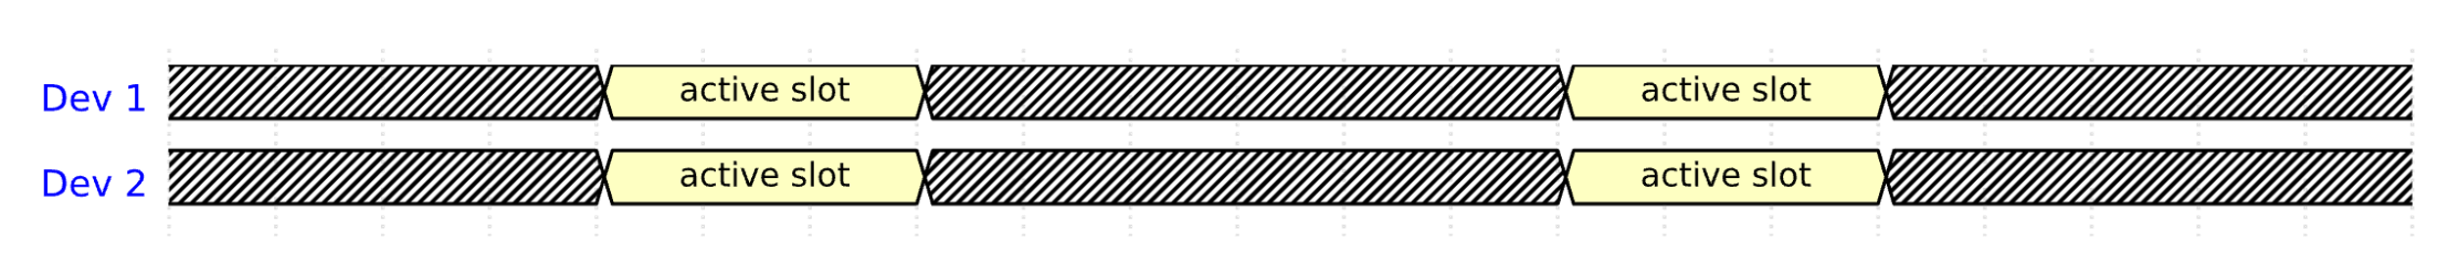
The Problem of Synchronous Communication
Devices agree on a rendezvous point in time to turn on their radios to exchange data
Example
Dev 1 and Dev 2 agree to exchange data in 1 minute
Dev 1 puts a timer for 1 minute, goes to sleep, when timer expires it starts transmitting
Dev 2 puts a timer for 1 minute, goes to sleep, when timer expires it starts listening
What will happen?

Slide 14
The Problem of Synchronous Communication
Devices agree on a rendezvous point in time to turn on their radios to exchange data
Example
Dev 1 and Dev 2 agree to exchange data in 1 minute
Dev 1 puts a timer for 1 minute, goes to sleep, when timer expires it starts transmitting
Dev 2 puts a timer for 1 minute, goes to sleep, when timer expires it starts listening
If Dev 1 and Dev 2 have no relative drift, it will work OK
If Dev 1’s clock faster, Dev 2 will miss the transmission
If Dev 2’s clock faster, Dev 1 will miss the listening window

Slide 15
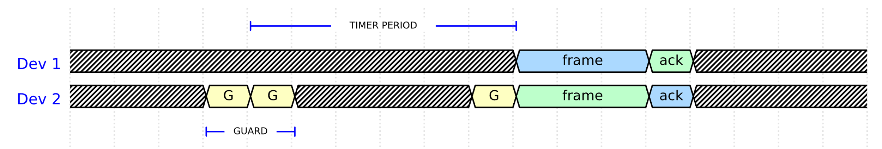
Guard Time
The receiver puts the radio in listen mode a bit before the rendezvous point and keeps it on for a while after to account for both positive and negative drift
Trade-off
Large guard time improves robustness to time sync error
But it increases the idle listening (and occupies bandwidth)
Blue: transmit
Green: receive
Yellow: listen
Gray: sleep

Slide 16
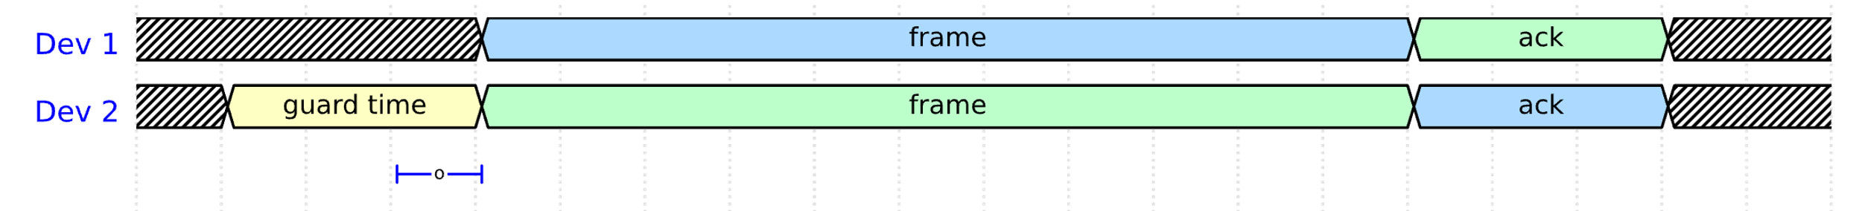
Implicit Synchronisation
Relative time synchronisation without explicit synchronisation frames (overhead)
Rendezvous-based MAC can have implicit synchronisation using the data frames
Receiver expects the transmission at T₁ but it happens at T₂
It can then calculate the offset as o = T₂-T₁
”Free” resynchronisation on each data transmission
A data transmission must happen before the synchronisation error becomes larger than what the guard time can handle
Runtime drift compensation
The drift is constant in the short term (assuming constant temperature)
The receiver can learn the drift by diving the offset to the time passed since last synchronisation
Blue: transmit
Green: receive
Yellow: listen
Gray: sleep

Slide 17
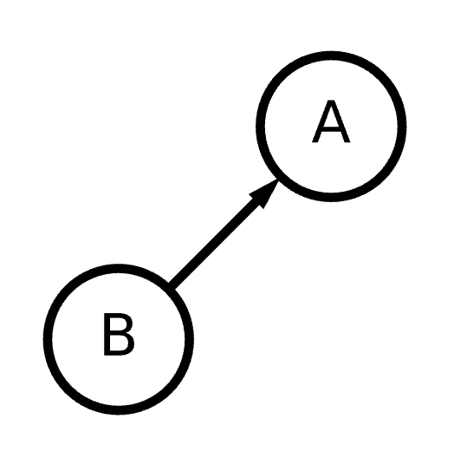
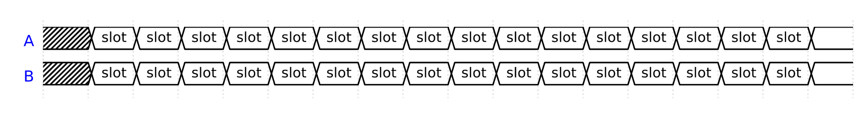
TSCH: Timeslots and Time Synchronisation
Network-wide Time Synchronisation
All devices in a TSCH network are time synchronised with each other
Relative time synchronisation based on the implicit synchronisation technique
Time is split into timeslots
Each slot is long enough to support:
Transmission of a frame of maximum size (~4 ms)
An acknowledgement (~0.35 ms)
The guard time (~2 ms)
Time required to switch from TX to RX mode, encryption/decryption
The duration of the timeslot is not imposed by the standard
Typical timeslot size is 10 ms
Some older radios are slow at switching from TX to RX mode and need 15ms

Slide 18
TSCH: Timeslot
A timeslot defines a transmission opportunity
An actual frame transmission may not happen if there is nothing to transmit!
The sender initiates the frame transmission at TxOffset after the beginning of the timeslot
The receiver listens to the channel for the time defined by the Guard Time (G)
The guard time is equally spaced around the expected transmission time to account for both positive and negative drift
If a preamble is captured within the guard time, the receiver stays on to capture the full frame
Otherwise, the receiver goes to sleep
After a frame transmission, sender and receiver swap the modes of their radios for the ACK
TxOffset
Tx Data
G
Rx ACK
Tx
G
Rx Data
Tx ACK
Rx
Timeslot Length

Slide 19
TSCH: Guard Time
The guard time allows for a certain degree of synchronisation error
Periodic synchronisation is required
Longer Guard Time
More robust to synchronisation errors
Less frequent synchronisation required
More idle listening, more energy consumption
Occupy the channel, bigger slots
Fewer slots per second, less data
Ideally as short as possible, but long enough to maintain robust synchronisation
Example
10 ppm drift, 2.2ms guard → sync. every ~100 seconds
10 ppm drift, 0.2ms guard → sync. every ~2 seconds
Time Sync in TSCH: https://doi.org/10.1109/LCN.2016.042

Slide 20
TSCH: Frame-Based and ACK-Based Synchronisation
TSCH uses implicit synchronisation with a neighbour on each frame transmissions
The receiver calculates the difference between the expected and actual time of frame arrival
In frame-based synchronisation, the receiver uses this offset to synchronise to the clock of the sender
In ACK-based synchronisation, the receiver adds this offset in the acknowledgement frame and the sender uses it to synchronise to the clock of the receiver
In the absence of data, devices need to exchange an empty Keep-Alive frame to re-synchronise
Significant overhead in applications that transmit very infrequently, e.g. smart metering
TxOffset
Tx Data
G
Rx ACK
Tx
G
Rx Data
Tx ACK
Timeslot Length

Slide 21
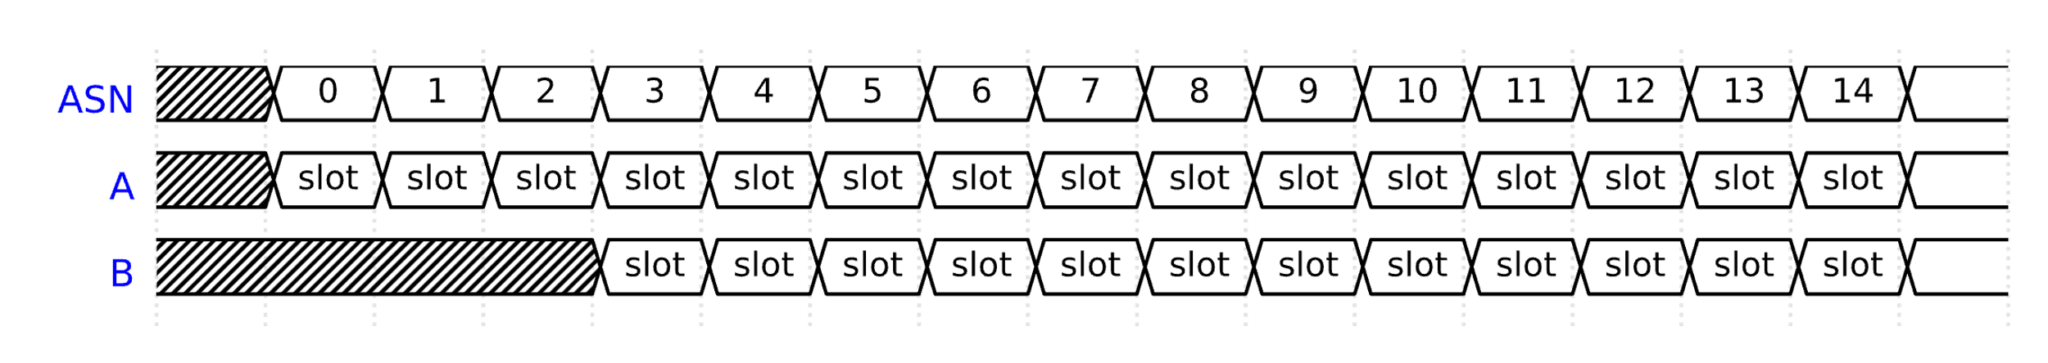
TSCH: Absolute Slot Number
A number that counts slots since the formation of the network
5 bytes so that it can increment for hundreds of years without wrapping
ASN Synchronisation
ASN is initialised to 0 by the device that forms the network
Devices learn the current value of ASN when they join the network
Since they are synchronised, all devices know the current value of ASN at any time

Slide 22
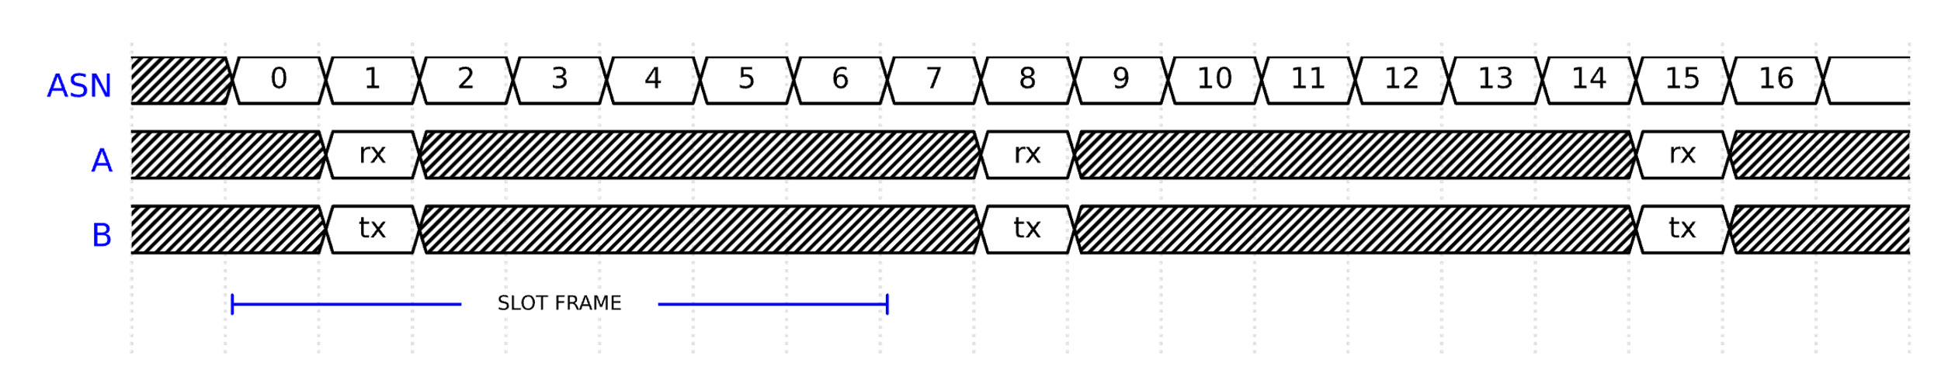
TSCH: Slot frame and Schedule
Time slots are organised in a slot frame
A slot frame is a continuously repeating pattern of slots
Slot frame size (not defined by the standard, tailored to the application)
[slot offset] = [ASN] % [slot frame size]
Communication is based on a schedule, for example:
Slot frame size = 7
B transits to A in slot offset = 1

Slide 23
TSCH: The Schedule Controls Several Performance Metrics
Assuming timeslot size 10 ms and frame size 7…
Link Capacity: 100 / 7 = 14.28 packets per second
Energy Consumption: 1 / 7 = 14.28% radio duty cycle
Latency: up to 7 x 10 ms = 70 ms

Slide 24
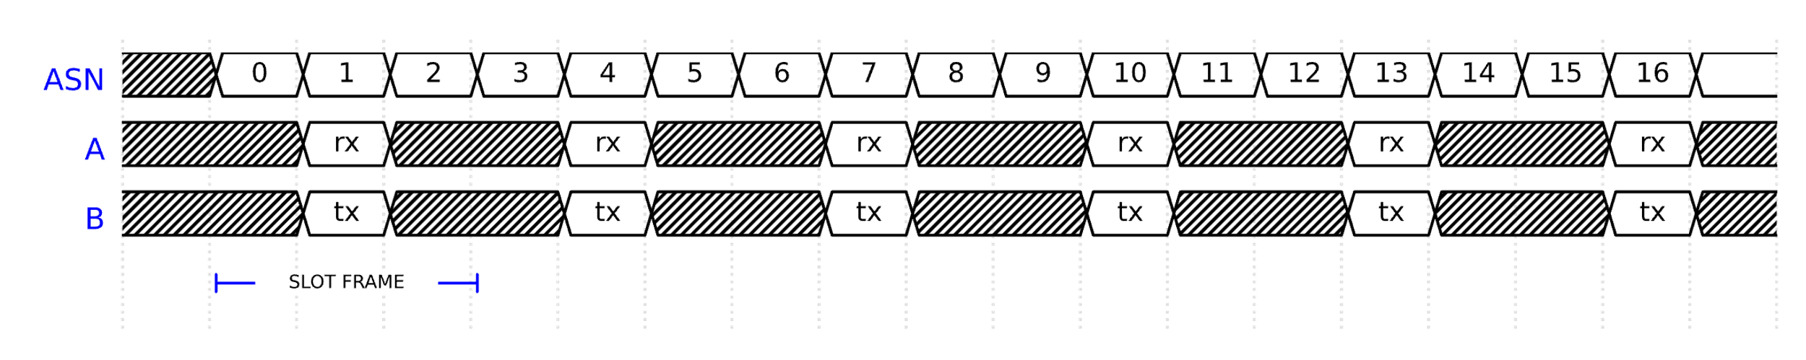
TSCH: Slot Frame Size
Defines the number of idle slots in a frame
Shorter slot frame size
More transmission opportunities → higher capacity for data
More re-transmission opportunities → higher reliability
Shorter average and worst-case latency
More unused slots → worse energy-efficiency
Less room for other devices → worse scalability

Slide 25
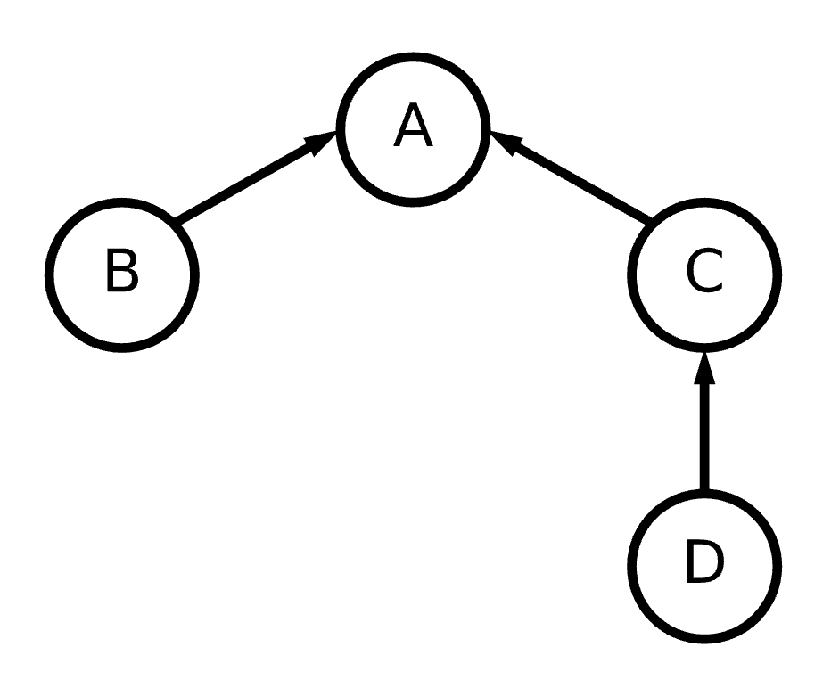
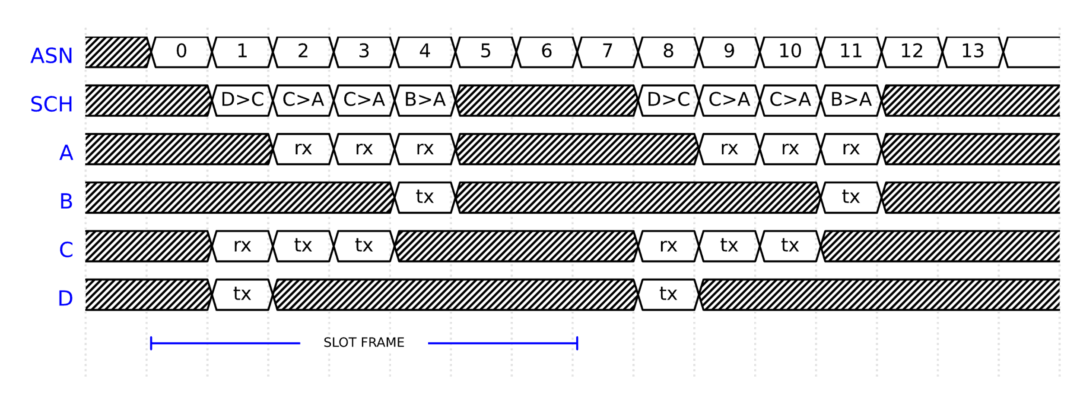
TSCH Schedule: Dedicated Slots
In each slot, a device can transmit (Tx), receive (Rx), or sleep (idle)
Dedicated slots (Contention-free)
Slot dedicated to a specific link
One assigned transmitter → no collisions
Example: B>A, means B transmits (Tx) and A receives (Rx)

Slide 26
TSCH Schedule: How many slots?
Why did I allocate 2 slots per frame for link C>A?
How many slots per frame I need generally?

Slide 27
TSCH Schedule: How many slots?
Slots in the schedule should be able to have capacity for:
Packet generation rate by the transmitter
Packet forwarding rate by the transmitter
Retransmissions (ETX, Expected Transmission Count)
ETX = 1/p where p is packet reception probability
Example: if p=20%, I need to retransmit each packet 5 times on average

Slide 28

TSCH Schedule: Broadcast Slots
Broadcast slots (every node active)
If I have something to broadcast, I transmit
If I have nothing to broadcast, I listen/receive
Typically, the first slot of the frame
Collisions may happen
Transmitters cannot receive broadcasts of others

Slide 29
Slots Are Limited
Assuming a time slot of 10 ms, there are only 100 slots per second
Permit for maximum 100 packets per second
What can do if we run out of slots, and we want to support more devices, traffic or retransmissions?

Slide 30
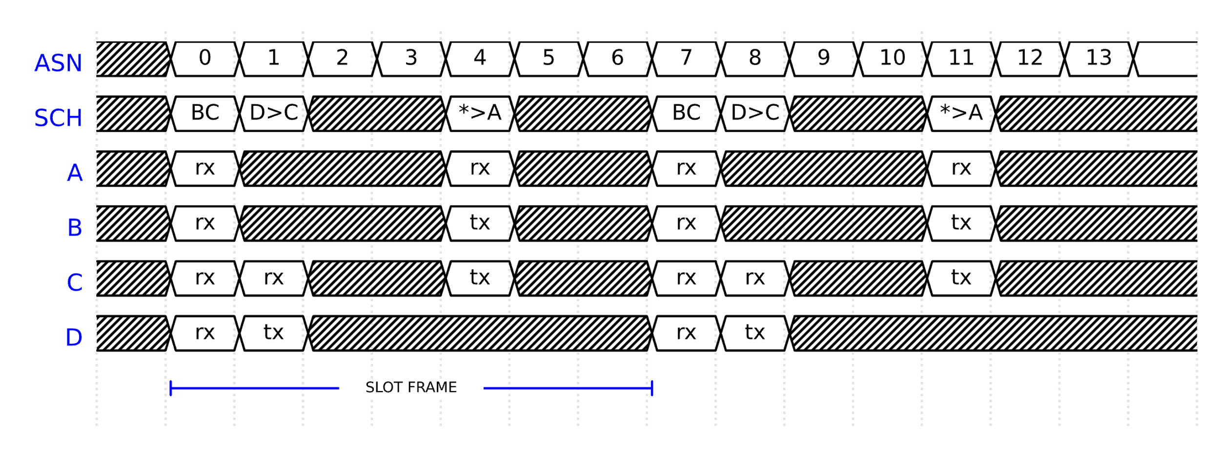
TSCH Schedule: Shared Slots
Shared slots (Contention-based)
Slot assigned to multiple transmitters
Collisions are possible, need CSMA/CA
Good for devices that transmit sporadically (e.g. event-based)

Slide 31
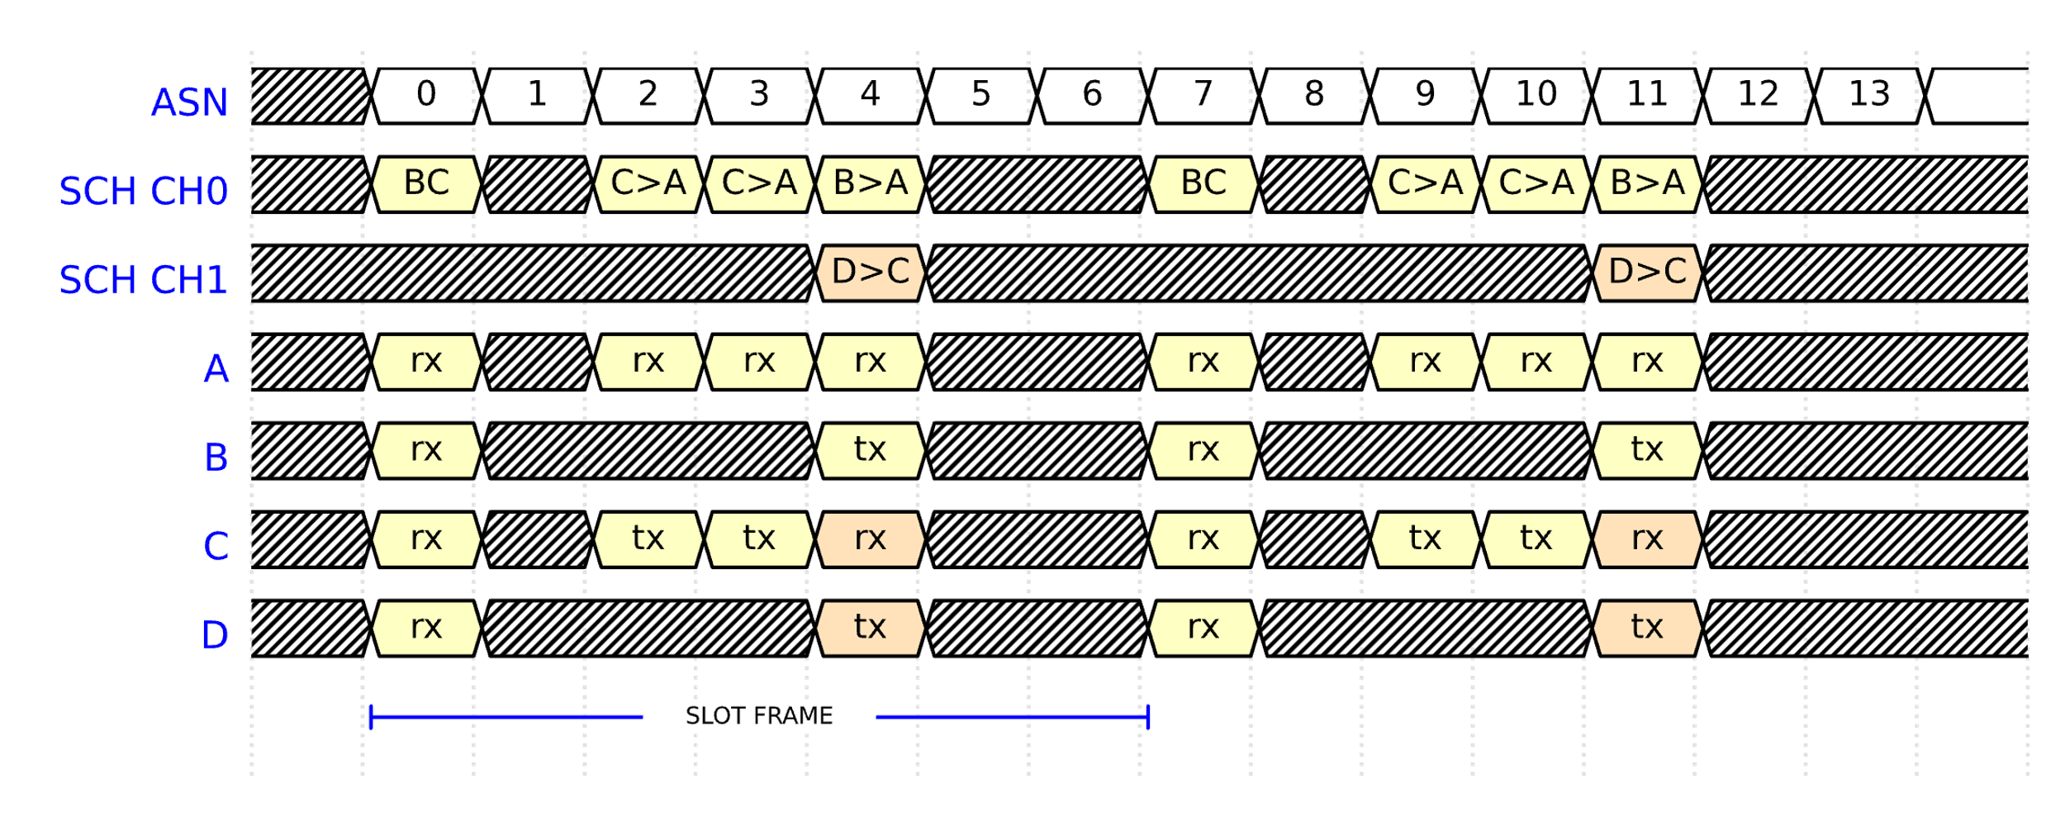
TSCH Schedule: Multiple Channels
Parallel transmissions are possible in different channels
A transmitter and receiver can only tune to one specific channel

Slide 32
Some Channels are better than others
IEEE 802.15.4 uses retransmissions to combat channel errors
Interference and fading errors are correlated in time
If a channel experiences a lot of interference now, it is very likely to experience a lot of interference in the next frame
Yet, interference and fading of different channels are often uncorrelated
If a channel experiences a lot of interference now, it is very likely that another channel will not be affected by the same source of in the next frame
Idea: Change channels for each retransmission to enhance reliability

Slide 33
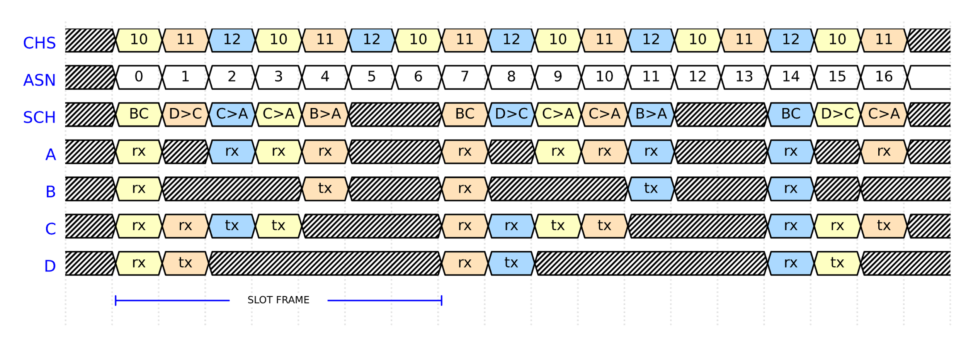
TSCH: Channel Hopping
Channels change following a pre-agreed pseudo-random order
All nodes agree on a Channel Hopping Sequence (CHS), e.g. 10-11-12
Channel = CHS[index], where index = ASN mod len(CHS)

Slide 34
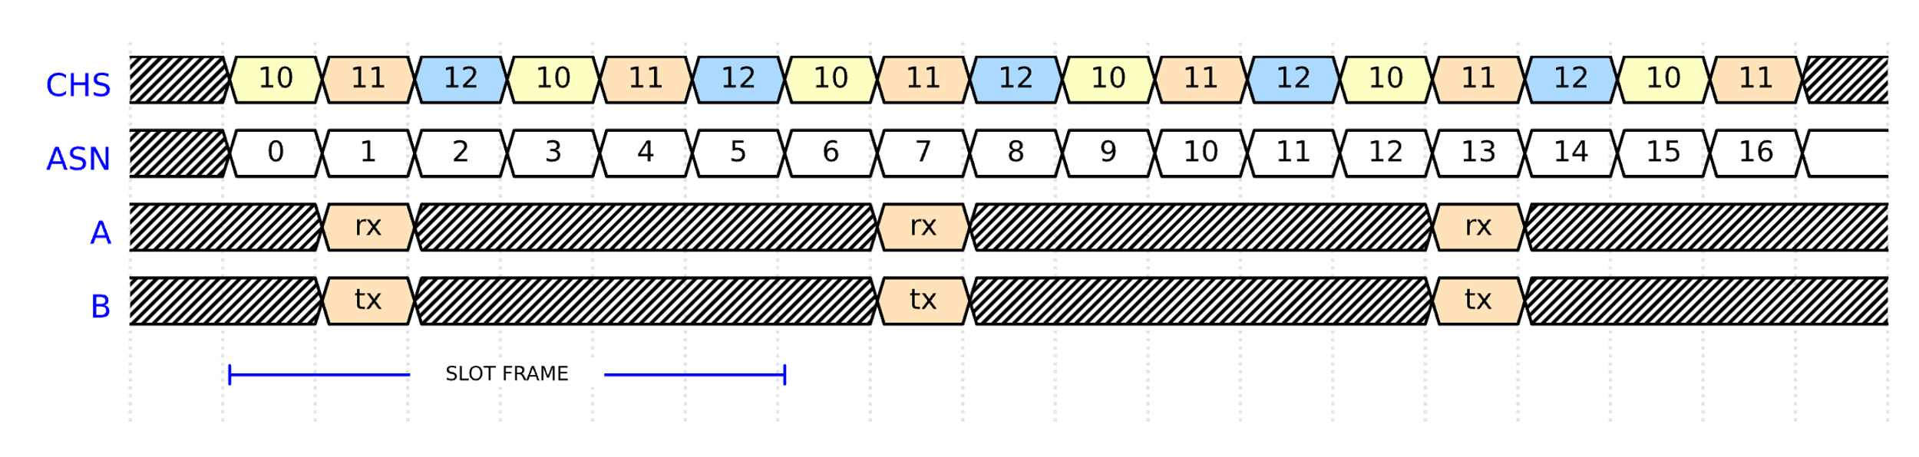
Slot Frame Size vs Channel Hopping Sequence Size
The Slot Frame Size and CHS size must be relatively prime
Their highest common factor should be 1
Otherwise, there is no channel hopping!
Example: frame size is 6 and CHS size is 3

Slide 35
The TSCH Schedule
A N-by-M table where N is the slot frame size and M is the CHS size
Each column represents a slot offset (SO)
Each row represents a channel offset (CHO)
Channel = CHS[index], where index = (ASN + CHO) mod len(CHS)
CHO \ SO | 0 | 1 | 2 | 3 | 4 | 5 | 6
0 | BC |  | C > A | C > A | B > A
1 |  |  |  |  | D > C
2

Slide 36
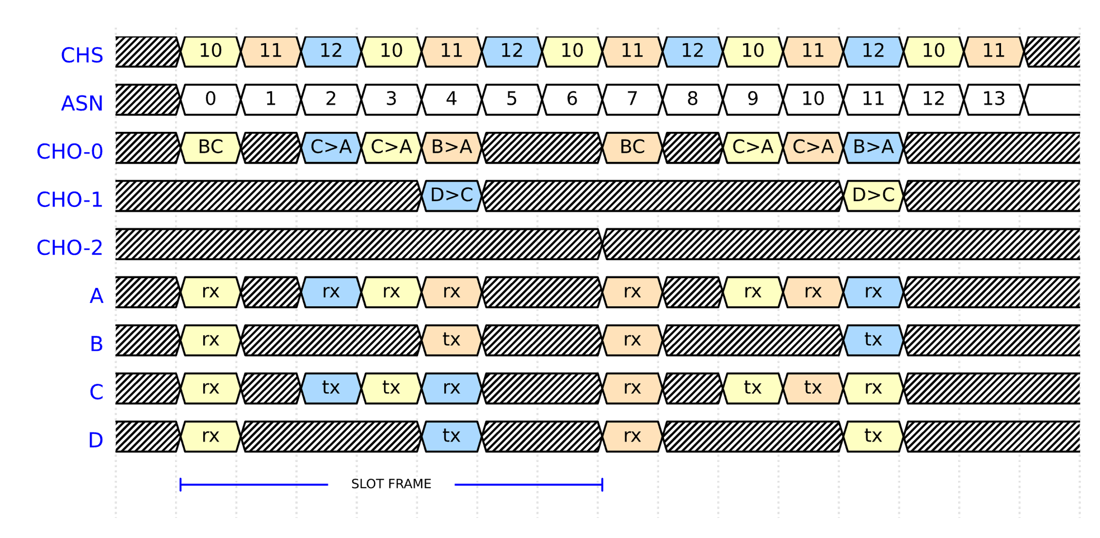
TSCH Schedule
Channel = CHS[index], where index = (ASN + CHO) mod len(CHS)

Slide 37
Channel Selection
Consider a channel with a lot of interference
Using as the only single channel is very bad
Using it as part of the CHS is better, but inefficient
How can we select which channels to use?
Some channels are busier than others
The quality of the channels changes over time
Adaptive Channel Selection
Measure the quality of channels
Update metrics with statistics
Select the best channels (blacklist/whitelist)
Distribute changes to the channel hopping sequence
Adaptive Channel Selection: https://doi.org/10.1109/GIOTS.2017.8016246

Slide 38
TSCH Scheduler
A TSCH Scheduler is an algorithm that determines the TSCH schedule
The Scheduler is not defined by the standard (flexible)
Schedules are tailored to the use case
Types of TSCH Scheduling
Static Scheduling
Dynamic Scheduling
Centralised Scheduling
Distributed Scheduling
Autonomous Scheduling

Slide 39
Static Scheduling
Schedule is hardcoded on the firmware of the devices
A static schedule can be handcrafted or algorithmically derived
Makes sense only in relatively static TSCH networks
No. of devices, topology, traffic patterns, expected retransmissions
CHO \ SO | 0 | 1 | 2 | 3 | 4 | 5 | 6
0 | BC |  | C > A | C > A | B > A
1 |  |  |  |  | D > C
2

Slide 40
Dynamic Scheduling
A minimal schedule with shared slots is defined
Hardcoded or installed when joining the network
Dedicated slots are allocated dynamically
Centralised Scheduling
The root node collects information about the nodes via these shared slots
Having the global picture of the network, it allocates dedicated slots to specific links
Such decisions can be determined using machine learning or reinforcement learning
Distributed Scheduling
Neighbouring nodes exchange information and agree on which slots to use between them

Slide 41
IETF Minimal Schedule and 6top
Minimal Schedule
One broadcast slot in offset (0,0)
The slot frame size and channel sequence size is undetermined
Hardcoded or installed when joining the network
6top (6TiSCH Operation Sublayer Protocol)
A protocol to exchange messages for distributed scheduling
6top Commands
Command | Code | Description
ADD | 1 | Add slot between two neighbours
DELETE | 2 | Delete slot from schedule
RELOCATE | 3 | Relocate slot in schedule
COUNT | 4 | Count slots
LIST | 5 | List slots
SIGNAL | 6 | Send command
CLEAR | 7 | Clear slots between two neighbours
CHO \ SO | 0 | 1 | 2 | 3 | 4 | 5 | …
0 | BC
1
…
6TiSCH and 6top: https://doi.org/10.1109/COMST.2019.2939407

Slide 42
Autonomous Scheduling
Each node derives and changes its schedule autonomously
No need to exchange messages
Cannot guarantee a collision-free schedule
Shared slots are used for the routing protocol to determine parent nodes
Nodes autonomously determine when to transmit/receive using routing information
Devices hash the Node ID or MAC address (of sender or receiver) modulo frame size to determine which slot to use
Orchestra is a widely used autonomous scheduler (albeit not a standard)
Orchestra: https://doi.org/10.1145/2809695.2809714

Slide 43
Joining a TSCH Network
How does a new device join a TSCH network?
A new device that wants to join a TSCH network:
Does not know the schedule (unless static scheduling is used)
Does not know the current ASN
Does not know when the beginning of a frame/slot is (not in sync)
Enhanced Beacon (EB)
Devices of the TSCH network periodically broadcast an EB to advertise the network
EB includes the current ASN and (part of) the schedule
The joining device scans the wireless medium for an EB but without knowing the time and channel of the transmission

Slide 44
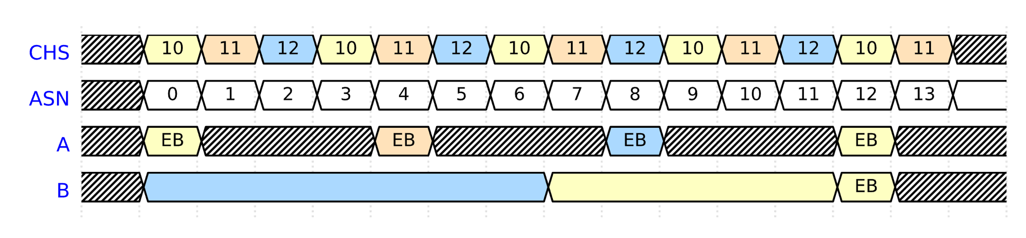
Searching for an EB packet
The joining node scans sequentially all the channels until it receives an EB
If the CHS is fixed, the joining node needs to search only those channels
Otherwise, it needs to search all 16 channels
Upon the reception of the first EB, the joining node keeps scanning for a potentially better parent until a timeout or a maximum number of candidate parents is reached
The joining process is notoriously slow and inefficient
But often considered insignificant in static TSCH networks as it ideally happens just once

Slide 45
Summary
IEEE 802.15.4 TSCH (Time-Slotted Channel Hopping)
A reliable wireless solution for the Industry 4.0
TSCH Mechanics
Efficient time synchronisation
Reliable communication based on a schedule
Interference avoidance with channel hopping
Centralised/Distributed/Autonomous scheduling
Joining a TSCH network

